Slide 1
Capstone Project-3
Cardiovascular Risk Prediction
(Supervised Machine Learning CLASSIFICATION)
BY
Sk Samim Ali,
Mohd. Izhar,
Sarath Haridas
(Cohort – Florence)

Slide 2

Problem Statement
The dataset is from an ongoing cardiovascular study on residents of the town of Framingham, Massachusetts.
The classification objective is to identify a patient's 10-year risk of future coronary heart disease(CHD).
The dataset contains information on the patients. It has 15 attributes and more than 4,000 records, approximately. Each quality has the potential to be risky. Risk factors might be medical, behavioural, or demographic.

Slide 3
Data Collection and Understanding
Demographic:
Whether a man or woman ("M" or "F")
Age: The patient's age (Continuous - Although the recorded ages have been truncated to whole numbers, the concept of age is continuous)
Behavioral:
is smoking: Whether the patient currently smokes or not ("YES" or "NO")
Cigs Per Day: The average number of cigarettes smoked by an individual each day (can be considered continuous as one can have any number of cigarettes, even half a cigarette).
Medical( history):
BP Meds: whether or not the patient was on blood pressure medication (Nominal)
Prevalent Stroke: whether or not the patient had previously had a stroke (Nominal)
Prevalent Hyp: whether or not the patient was hypertensive (Nominal)
Diabetes: whether or not the patient had diabetes (Nominal)

Slide 4
Data Collection and Understanding
Medical( Current):
Tot Chol: total cholesterol level (Continuous)
Sys BP: systolic blood pressure (Continuous)
Dia BP: diastolic blood pressure (Continuous)
BMI: Body Mass Index (Continuous)
Heart Rate : heart rate(Continuous) – In Medical research, variables such as heart rate though in face discrete, yet are considered continuous because of large number of possible values.
Predict Variable(desired target):
10-year risk of coronary heart disease CHD(binary: “1” means “Yes” and “0” means “No”) - DV

Slide 5
Inspecting Dataset
NumPy, pandas, seaborn, matplotlib, sklearn, XGboost, imblearn, and statsmodule were used, among other libraries.
The shape of the dataframe is (3390, 17) i.e. 3390 records and 17 columns.
The id column is being removed because it only contains a unique id for each patient and isn't going to be used for prediction.
Missing value count and percent in each column are as follows:
glucose – 304 (8.97%)
education – 87 (2.57%)
BPMeds – 44 (1.30%)
totChol – 38 (1.12%)
cigsPerDay – 22 (0.65%)
BMI – 14 (0.41%)
heartRate – 1 (0.03%)
Replacing the NaN values with median, in all the columns.

Slide 6
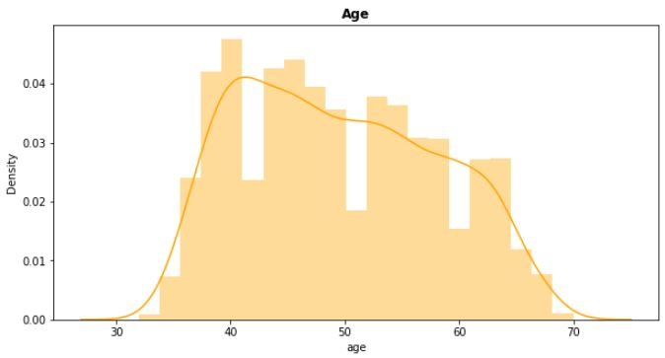
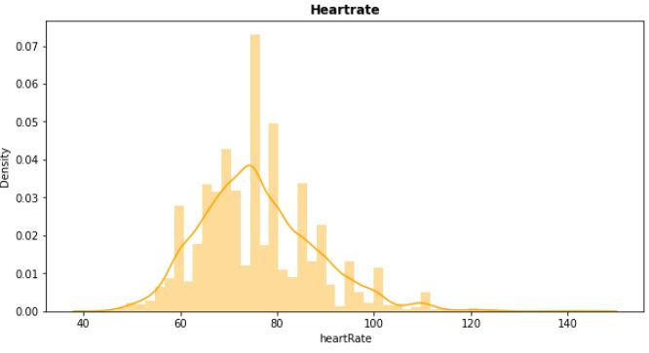
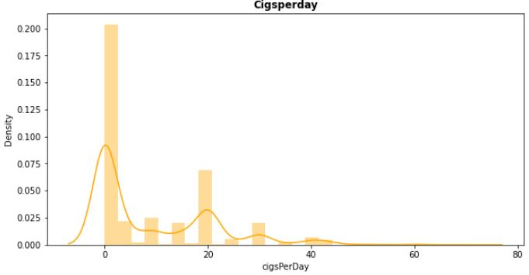
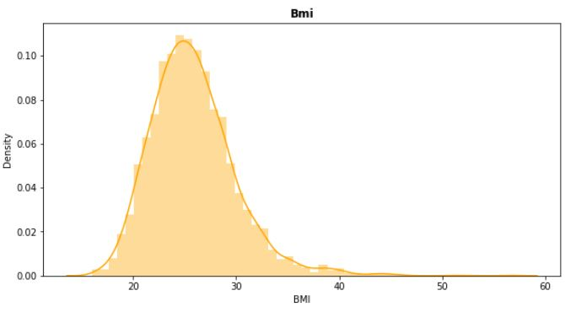
Visualization of Distributions

Slide 7
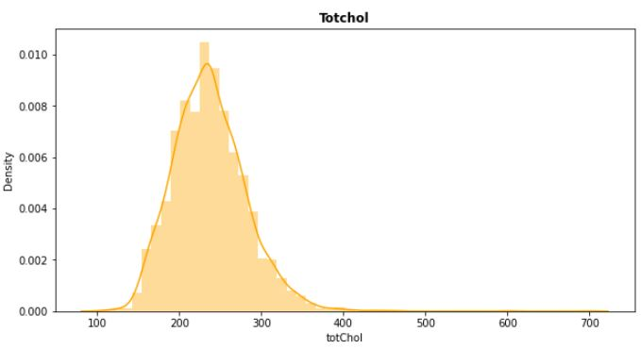
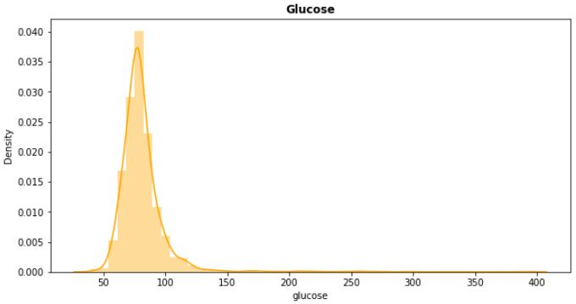
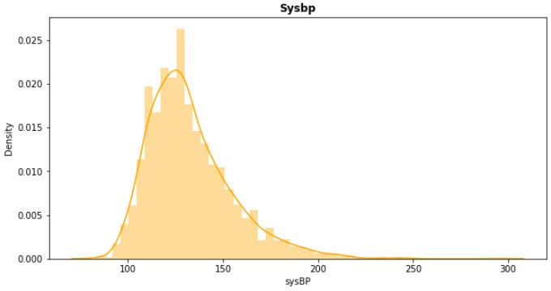
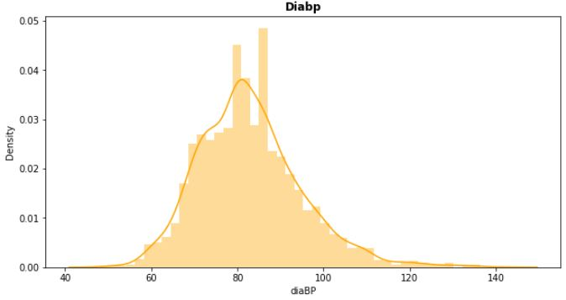
Visualization of Distributions

Slide 8
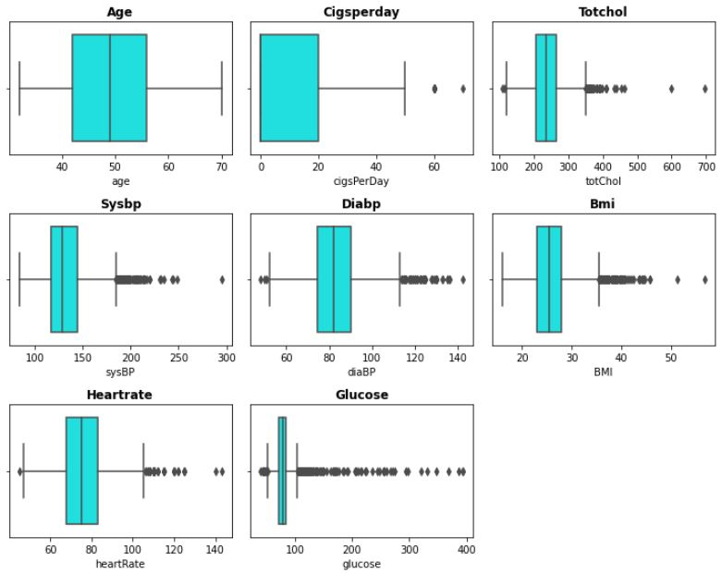
Checking Outliers:
We can clearly see outliers in some columns. So, We treated it by replacing them with the median values.

Slide 9
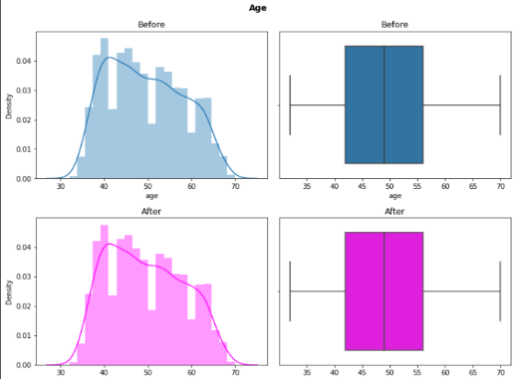
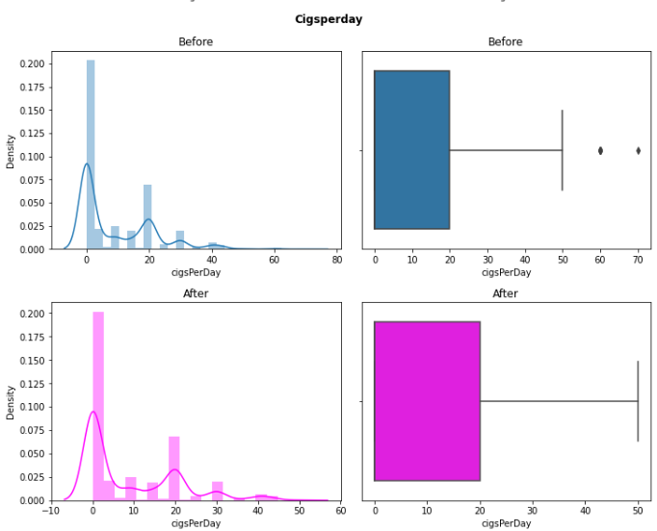
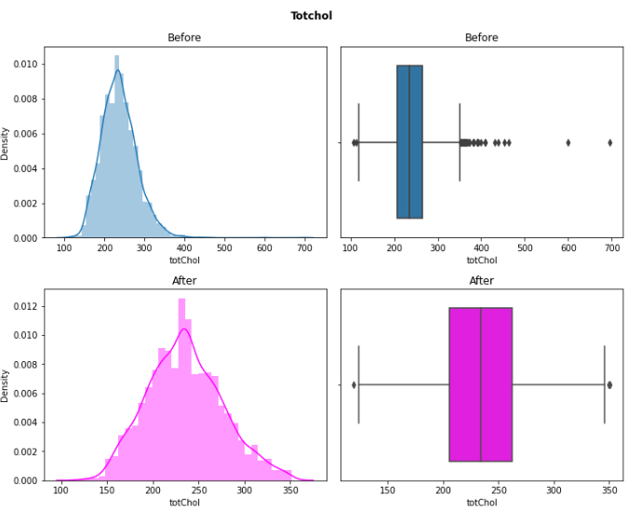
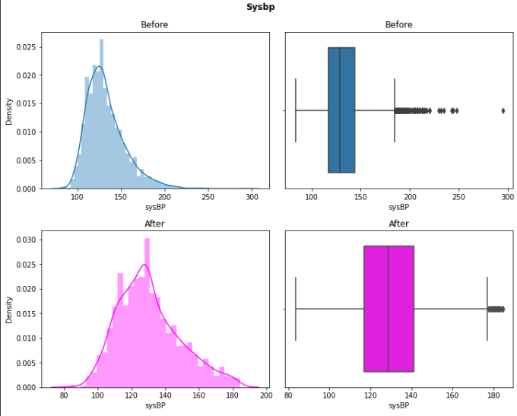
Handling Outliers

Slide 10
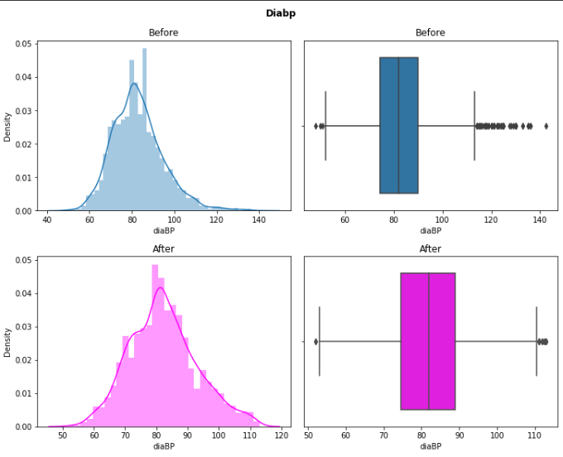
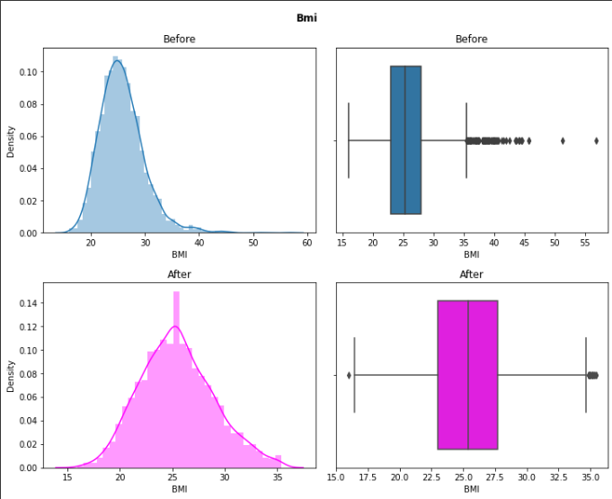
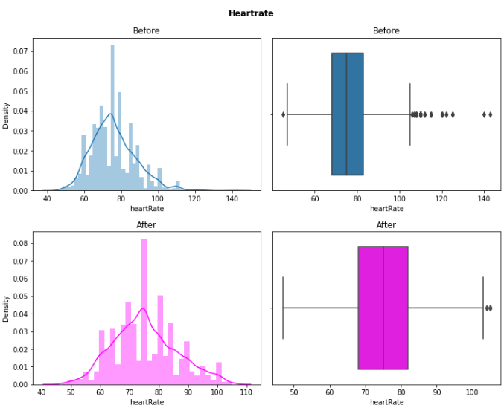
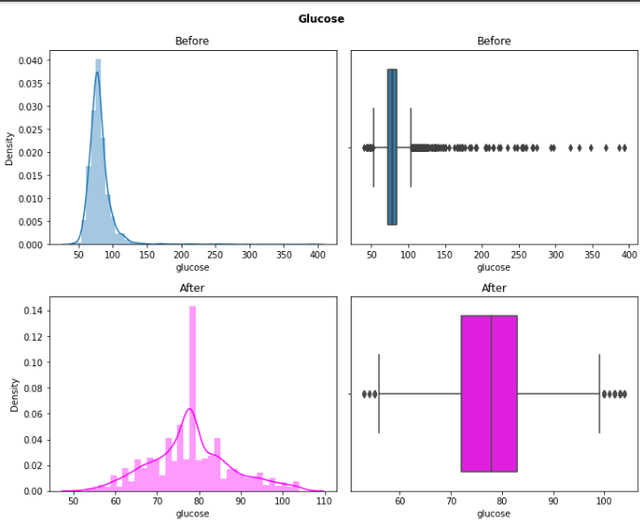
Handling Outliers

Slide 11
Cleaning and Manipulating the Dataset
There are no duplicate records in the dataframe, according to a check of the datasets for duplicate values.
Defining an encoder to convert such values into numeric values by comparing unique values with their counts in categorical characteristics.
Replaced “M” with 1 and “F” with 0 in the sex column.
Replaced “YES” with 1 and “NO” with 0 in the is_smoking column.

Slide 12
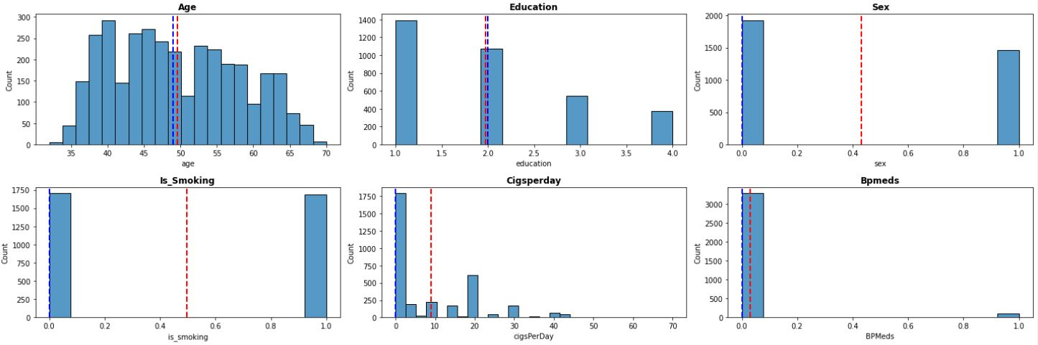
Univariate Analysis
Understanding the distribution of values for a single variable is the goal of univariate analysis. It is employed to describe each and every feature. Measures of dispersion, such as standard deviation and variance, show how widely spaced out the values in the datasets are, while measures of central tendency
Red and blue lines in the plot represent the mean and median respectively.

Slide 13
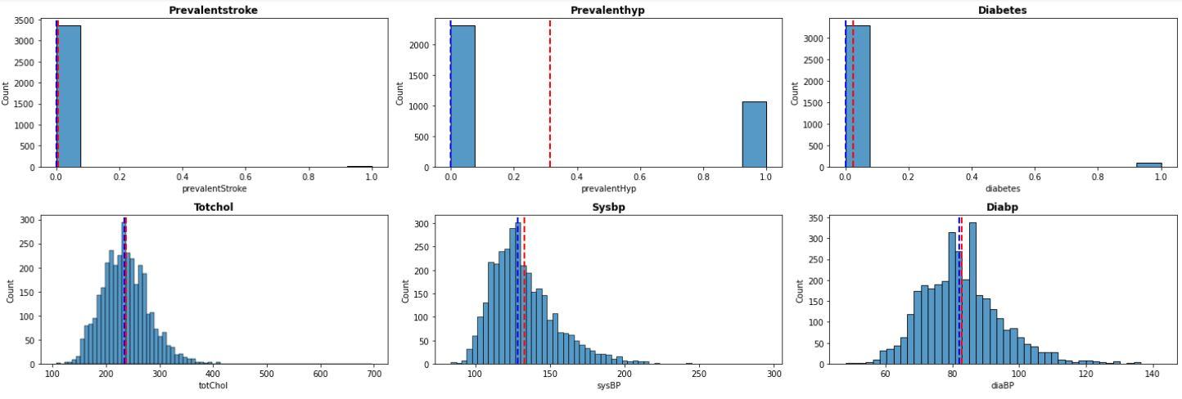
Univariate Analysis

Slide 14
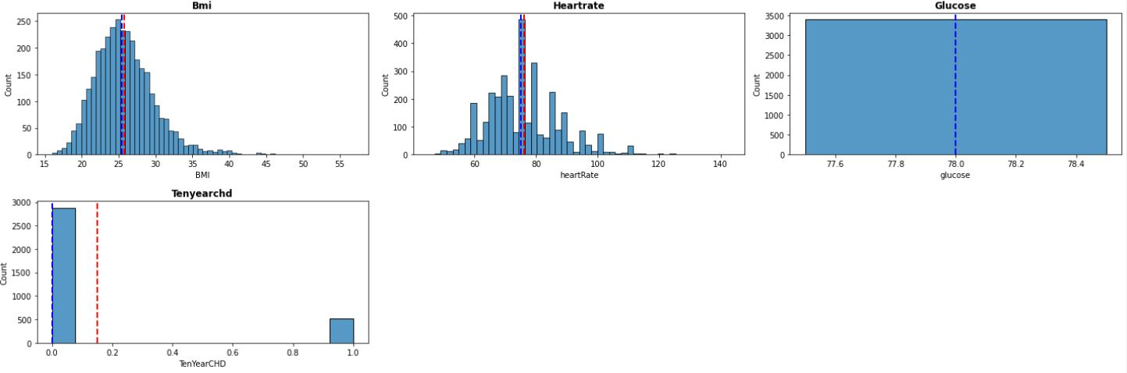
Univariate Analysis

Slide 15
Univariate Analysis
Observations:
Most of the individuals in our dataset are in their 40s to 50s of age.
Data show that there are more women than men.
The dataset has an equal number of smokers and non-smokers.
The average person smokes fewer than 10 cigarettes each day.
Few people have diabetes, high blood pressure, and a history of strokes.
The remaining features all seem to be distributed appropriately.
Very few individuals in the dataset supplied also have a risk for coronary heart disease. As a result, we also need to address the issue of class imbalance, which is covered in the next slides.

Slide 16
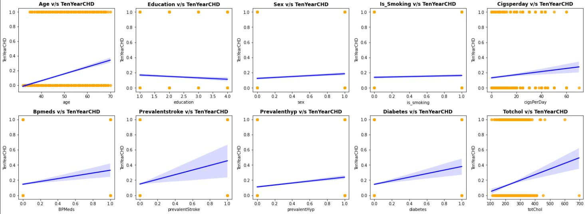
Bivariate Analysis
In Bivariate analysis we are visualizing the relation between dependent variable and rest of the independent variable.

Slide 17
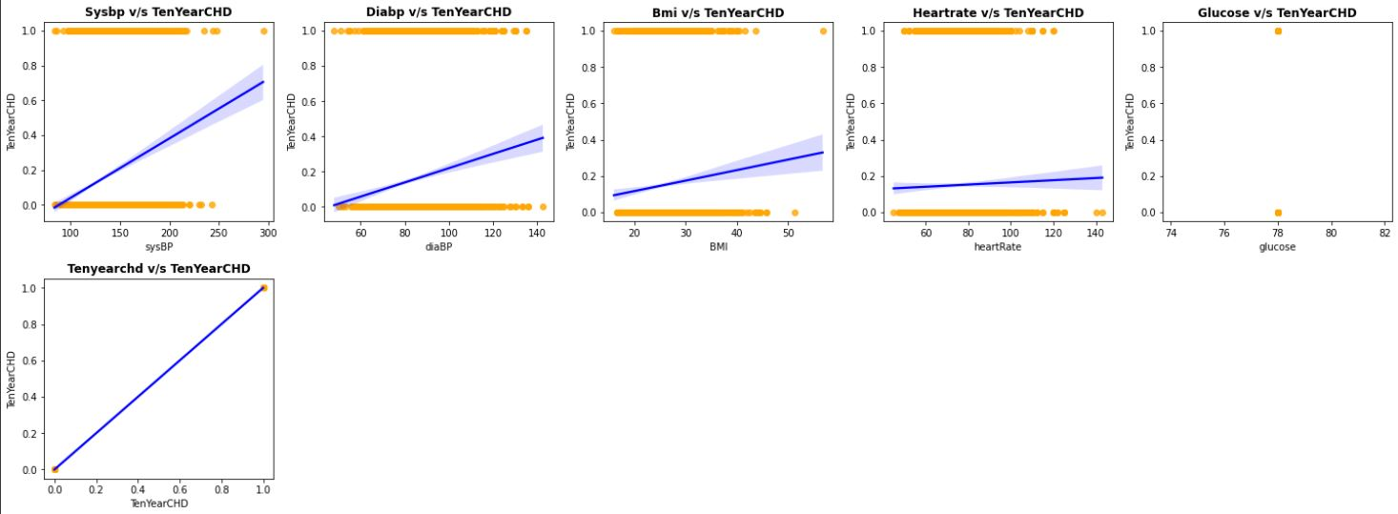
Bivariate Analysis
The plots show that the dependent variable has a clear-cut positive relationship with age, bmi, totchol, sysbp, diabp, etc., while the other features have nominal associations.

Slide 18
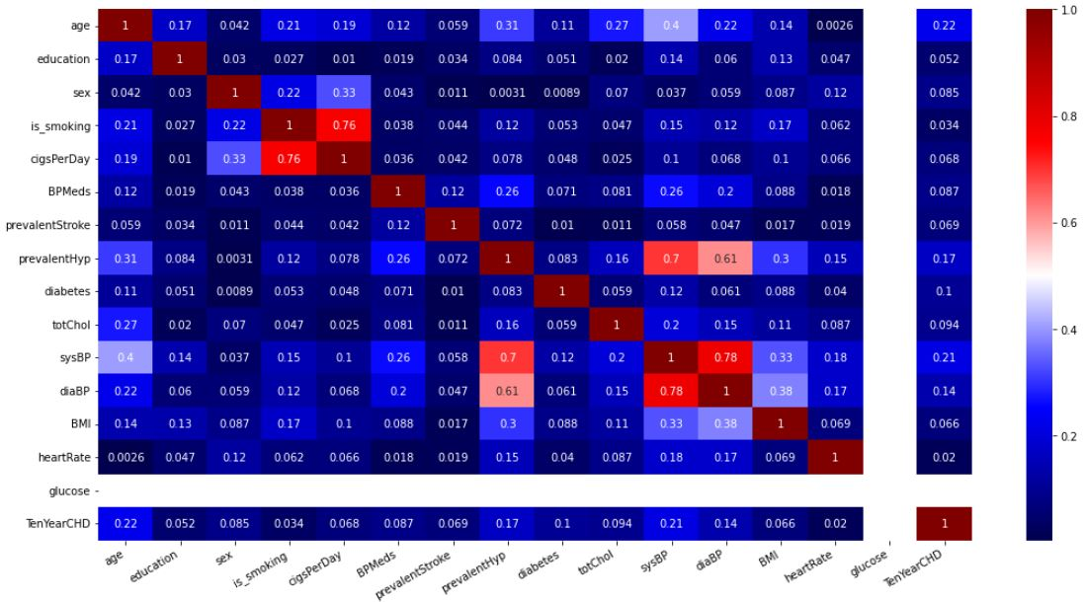
Multivariate Analysis

Slide 19
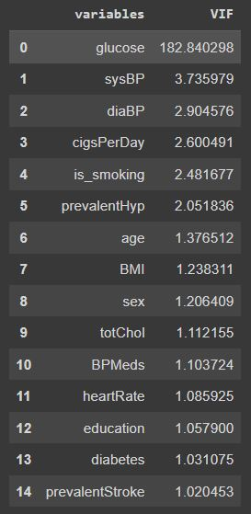
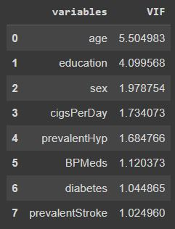
Handling Multicollinearity
Checking the multicollinearity between all the features, there are some features which are highly correlated with each other like is_smoking and cigsperday and so on.
To handle the multicollinearity we have used VIF score of all independent variable which represents how well the variable is explained by other independent variables.
we have excluded the features whose VIF score is higher than 10. Pictures in the left and right shows the VIF scores of variables before and after multicollinearity treatment.

Slide 20
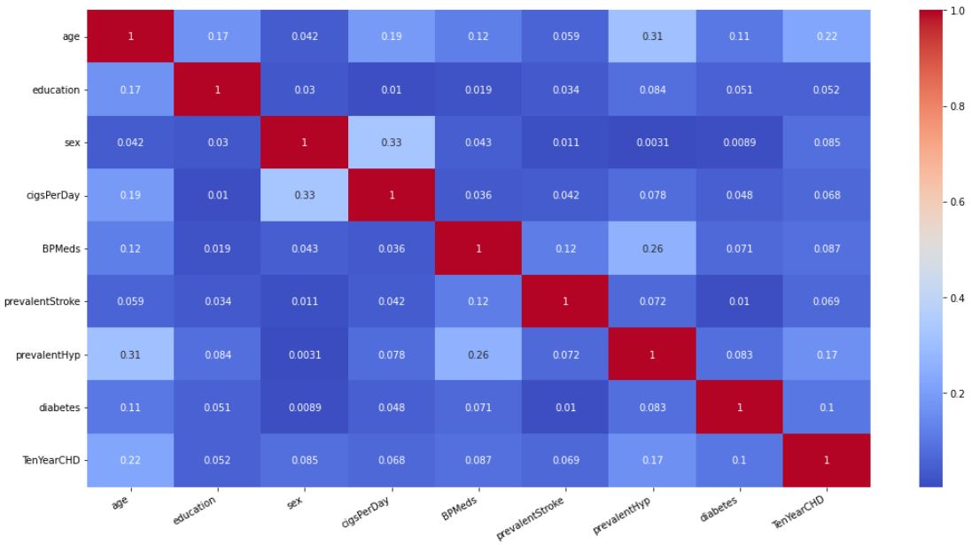
After Handling Multicollinearity (Updated heatmap)

Slide 21
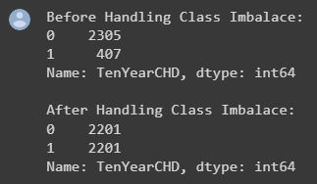
Model Building Prerequisites
Using Minmax scaler for scaling the features.
Making a variable to specify the F1 score of the target variable's class 1 will allow you to use it when tweaking the hyperparameters because Gridsearch will by default maximise the Macro Average of the F1 score for all classes. However, we aim to improve class 1's F1 score.
The data must be split into train and test sets in an 80-20 ratio, and X and Y variables must be defined.
Using SMOTE to address class imbalance and oversample, and then removing the Tomek links.
Finally Checking value counts for both classes Before and After handling Class Imbalance.
The description of a function that takes as inputs a classifier model and train-test splits and outputs a classification report for the model's performance on the train-test data. plots the relevance of the characteristic as well.

Slide 22
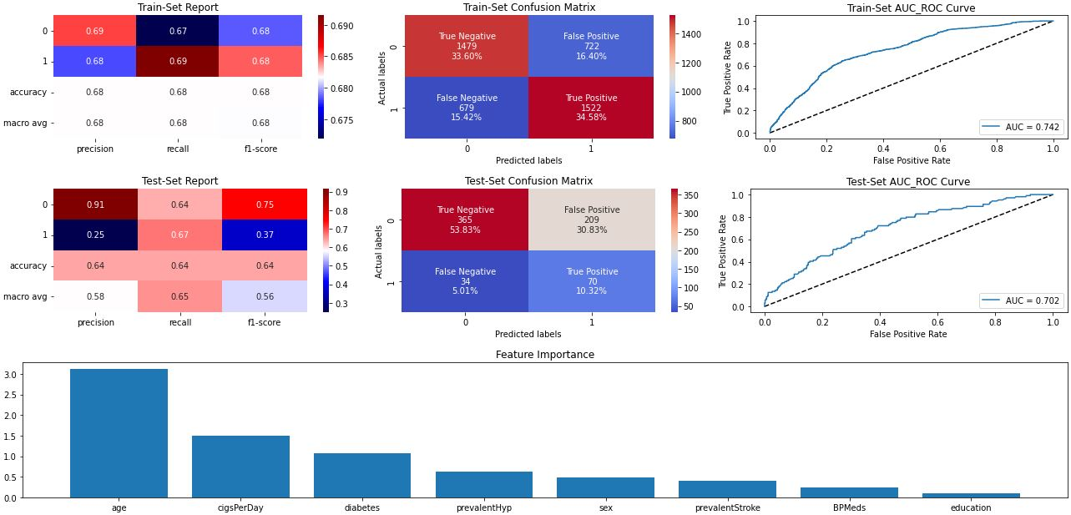
Logistic Regression

Slide 23
Logistic Regression
Before working with the complex models, start with the simple ones. Test data show that logistic regression results in the following for class 1:
Precision - 0.25
Recall – 0.67
F1 Score – 0.37
The feature significance plot is built using the z beta coefficients (i.e. before applying sigmoid function).
Age is the most influencing feature, followed by CigsPerDay followed by diabetes.

Slide 24
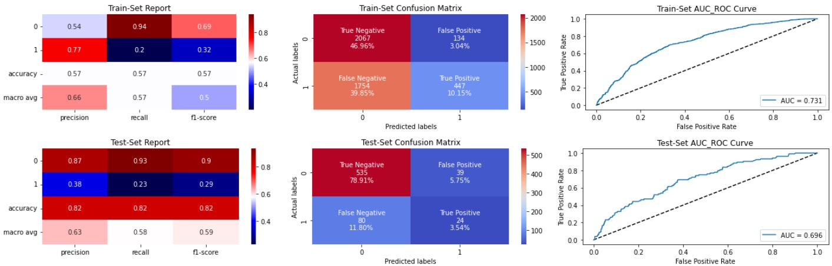
Naïve Bayes Classifier
It is simple to implement the Nave Bayes Classifier and compare it to other models as a benchmark model. For class 1, it generates the following outcome using test data:
Precision - 0.38
Recall – 0.23
F1 Score – 0.29

Slide 25
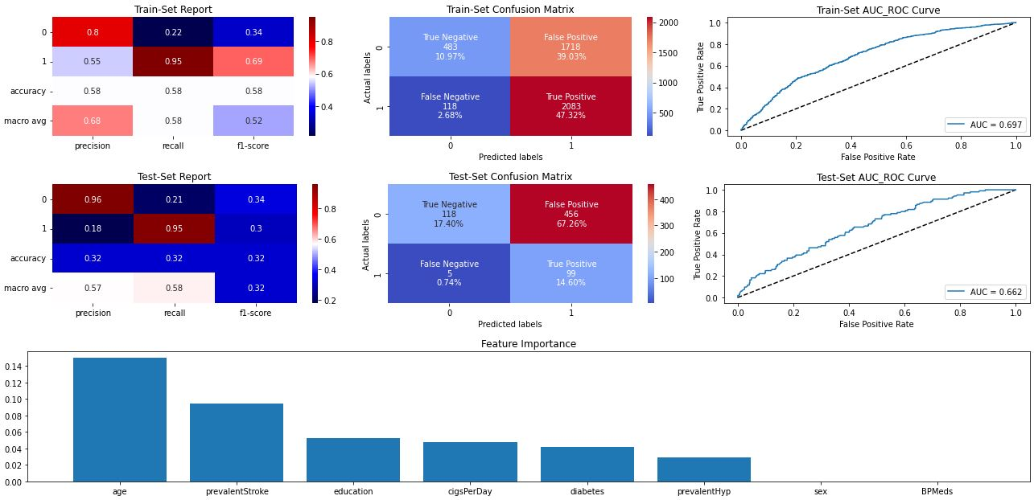
Support Vector Classifier

Slide 26
Support Vector Classifier
Support Vector Classifier with C=0.1 outputs following result for class 1 on test data:
Precision - 0.18
Recall – 0.95
F1 Score – 0.3
The most important factor is age, then prevalence of stroke, then education.

Slide 27
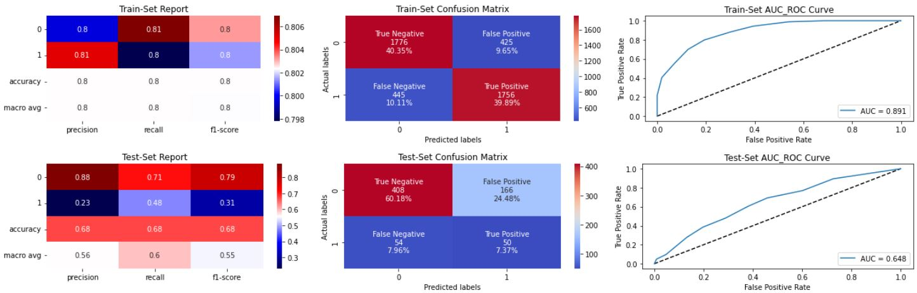
KNN Classifier
KNeighborsClassifier(metric= 'manhattan’, 'n_neighbors=5) gives following result for class 1 on test data:
Precision - 0.23
Recall – 0.48
F1 Score – 0.31

Slide 28
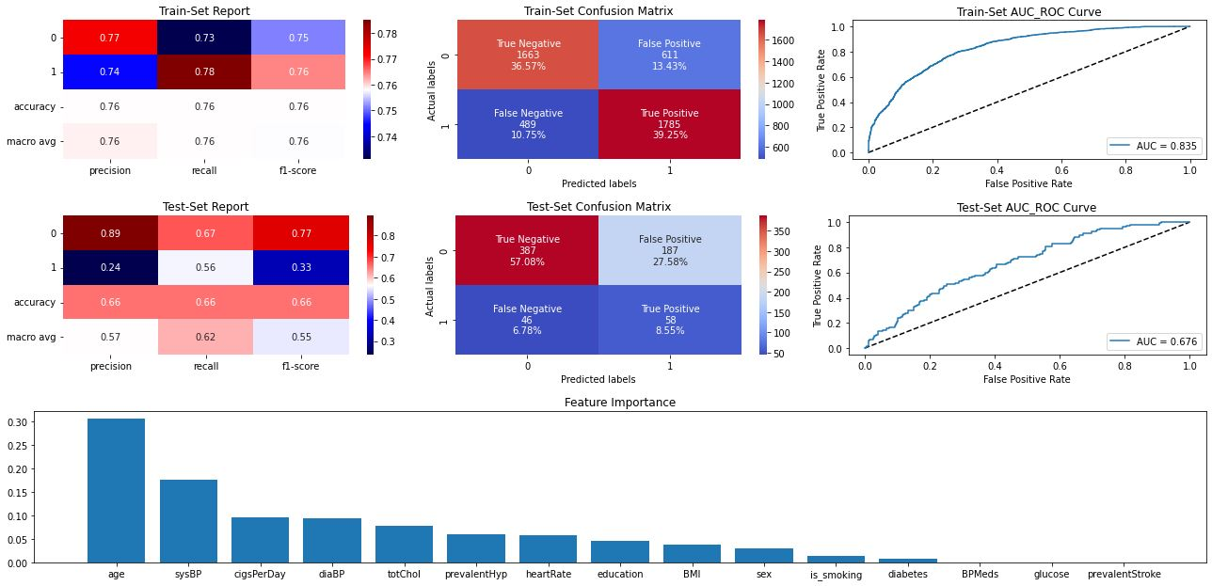
Random Forest Classifier

Slide 29
Random Forest Classifier
RandomForestClassifier(max_depth=8, min_samples_leaf=46, min_samples_split=50) gives following result for class 1 on test data:
Precision - 0.24
Recall – 0.56
F1 Score – 0.33
The attribute with the highest overall importance for the majority of the trees in the RandomForest Ensemble appears to be age, followed by sysBP.

Slide 30
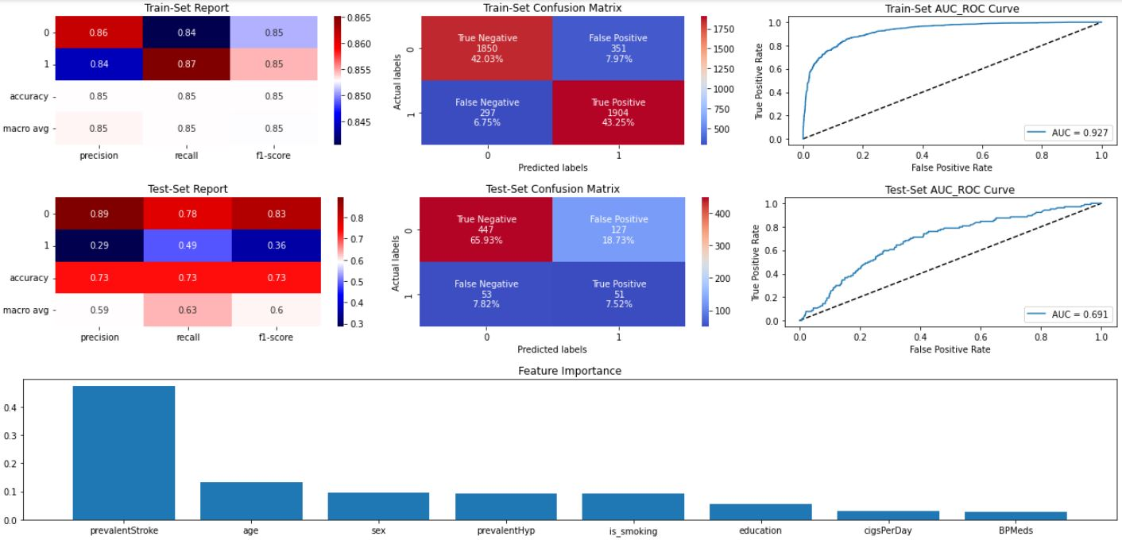
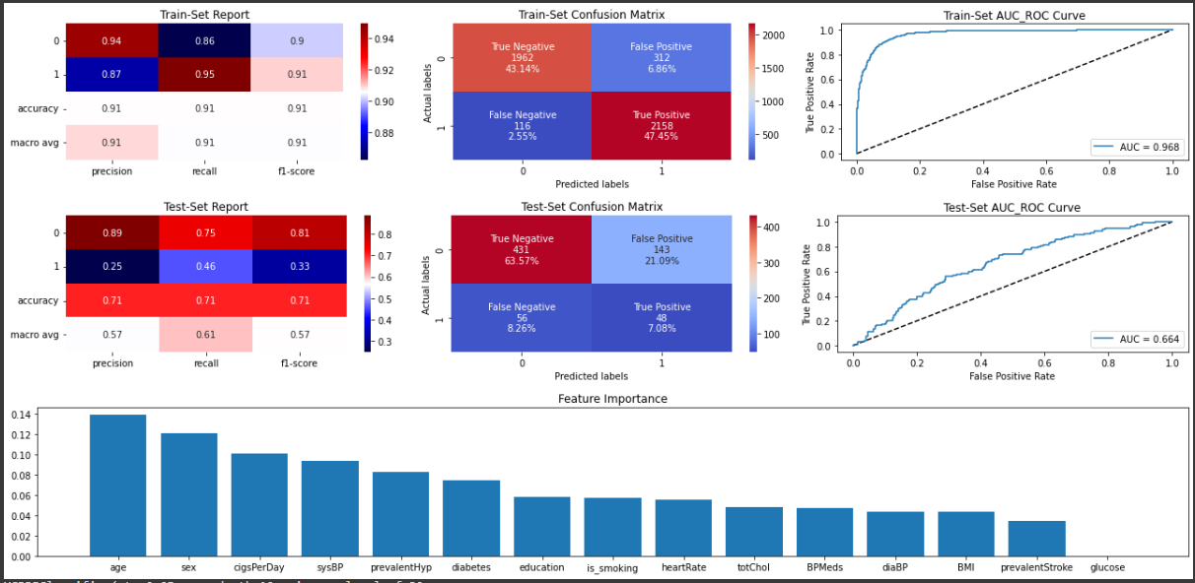
XGBoost Classifier

Slide 31
XGBoost Classifier
XGBRFClassifier(eta=0.05, max_depth=10, min_samples_leaf=30, min_samples_split=50, n_estimators=150) gives following result for class 1 on test data:
Precision - 0.25
Recall – 0.46
F1 Score – 0.33
Age and sex appear to be the feature with high global importance for most of the trees in the XGBoost tree Ensemble.

Slide 32
Conclusion
A high recall is preferred if we wish to absolutely rule out any scenarios where the patient has cardiac disease. A high degree of precision is preferred if we wish to avoid treating a patient who has no heart disease.
We seek a balance between precision and recall, and a high f1 score is sought, assuming that in our scenario the individuals who were mistakenly diagnosed as having heart disease are equally relevant because they could be suggestive of some other illness.
Since we added synthetic datapoints to the training set to address the extreme class imbalance, the data distribution between the train and test sets is different, and this difference accounts for the excellent performance of the models in the train set rather than overfitting.
Best performance of Models on test data based on evaluation metrics for class 1:
Recall - SVC
Precision - Naive Bayes Classifier
F1 Score - Logistic Regression, XGBoost
Accuracy - Naive Bayes Classifier

